Slide 1
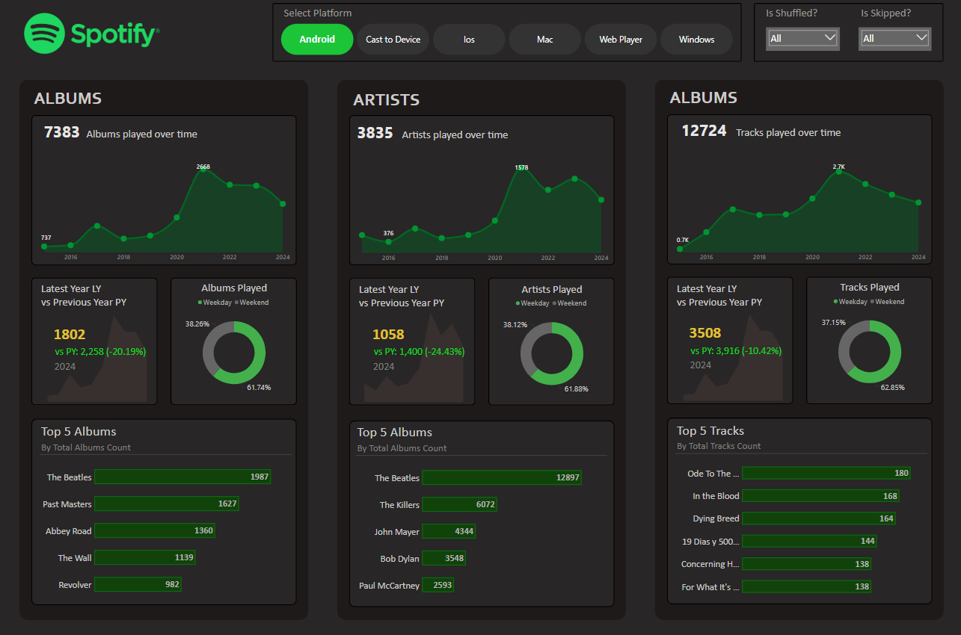

Slide 2
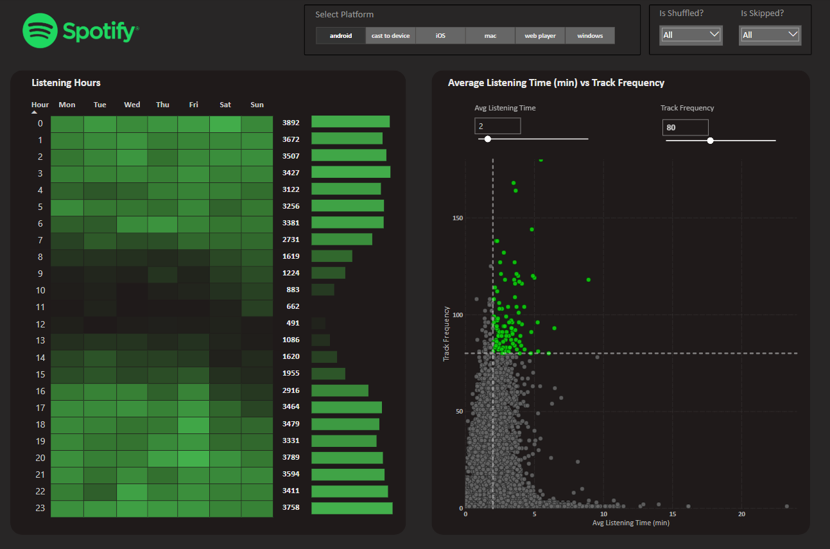

Slide 3

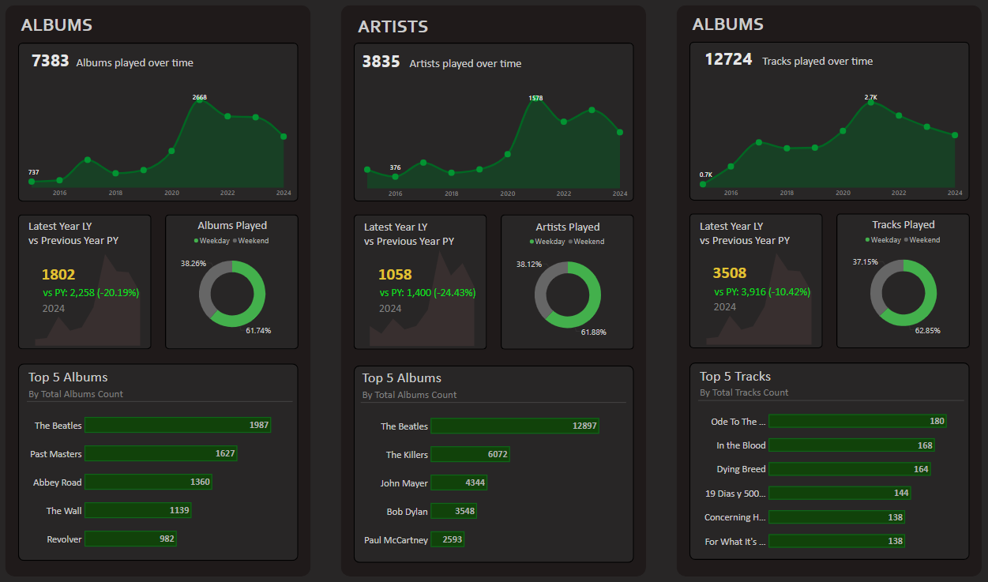
STEPS IN PROJECT
Requirement Gathering/ Business Requirements
Data Walkthrough
Data Connection
Data Cleaning / Quality Check
Data Modeling
Data Processing
DAX Calculations
Dashboard Lay outing
Charts Development and Formatting
Dashboard / Report Development
Insights Generation

Slide 4
BUSINESS REQUIREMENT
In today’s digital music era, understanding listening patterns is crucial for both users and streaming platforms. This analysis focuses on Spotify Albums Data, providing insights into user engagement with albums over time.
ALBUMS
🎵 Total Albums Played Over Time – Track how album listening trends change over months and years. 📅 Number of Albums Listened by Year – Identify annual listening habits and volume (Find the Min and Max Albums in the view).
💥Albums Played on Weekday & Weekend – Identify the Pattern of music listening on weekdays and weekends. 🏆 Top 5 Albums – Identify the most played albums based on listening frequency.
📊 Latest Year vs Previous Year Analysis – Compare album consumption between the latest and previous years, including:
LY (Latest Year) vs PY (Previous Year) Trends
YoY (Year-over-Year) Growth Analysis

Slide 5
BUSINESS REQUIREMENT
ARTISTS
🎵 Total Artists Played Over Time – Track how artist listening trends evolve across months and years.
📅 Number of Artists Listened by Year – Identify annual listening habits and artist diversity. (Find the Min and Max Artists in the view).
💥Artists Played on Weekday & Weekend – Identify the Pattern of music listening on weekdays and weekends. 🏆 Top 5 Artists – Identify the most played artists based on listening frequency.
📊 Latest Year vs Previous Year Analysis – Compare artist engagement between the latest and previous years, including:
LY (Latest Year) vs PY (Previous Year) Trends
YoY (Year-over-Year) Growth Analysis

Slide 6
BUSINESS REQUIREMENT
TRACKS
🎵 Total Tracks Played Over Time – Monitor how track listening trends change across months and years
📅 Number of Tracks Listened by Year – Identify annual listening habits and track diversity. (Find the Min and Max Tracks in the view).
💥Tracks Played on Weekday & Weekend – Identify the Pattern of music listening on weekdays and weekends.
🏆 Top 5 Tracks – Identify the most played tracks based on listening frequency.
📊 Latest Year vs Previous Year Analysis – Compare track engagement between the latest and previous years, including:
LY (Latest Year) vs PY (Previous Year) Trends
YoY (Year-over-Year) Growth Analysis

Slide 7
BUSINESS REQUIREMENT
LISTENING PATTERNS
🕒 Listening Hours Analysis – Identify peak listening times using a Heat Map that visualizes patterns across hours and days with color intensity. 📊 Average Listening Time (min) vs Track Frequency – Use a Scatter Plot with Quadrant Analysis to categorize tracks based on:
High Frequency & High Listening Time – Most engaging tracks 🎯
Low Frequency & High Listening Time – Niche but impactful tracks
High Frequency & Low Listening Time – Short & frequently played tracks
Low Frequency & Low Listening Time – Less popular tracks

Slide 8
BUSINESS REQUIREMENT
DETAILS GRID
In this report, we aim to analyze Spotify data by creating an interactive and dynamic Grid View. The Grid will display key details such as Album Name, Artist Name, Track Name, and other relevant attributes.
Key Requirements:
Grid View with Essential Fields:
The Grid should present critical data points for an intuitive and structured view.
2. Drill Through Functionality:
Users should be able to drill through from the main reports to explore underlying data for detailed insights.
The drilled-through data should be exportable to a CSV file based on user requirements.
3. Drill Down, Drill Up, and Hierarchy:
The Grid should support hierarchical navigation, allowing users to drill down and up for in-depth data exploration.

Slide 9
ALBUMS ANALYSIS
After analysing the data of Spotify we got required insights from it, which are listed below as per the business requirements mentioned for the data. Focusing on user engagement with albums and it increased over time.
ALBUMS
Total Albums Played Over Time – After tracking album trends overall, we got that albums played over time is 7907.
Number of Albums Listened by Year – As per analysis minimum albums played overall platforms was in 2014 (No. of albums- 22) and maximum albums played was in 2021 (No. of albums- 2668).
Albums Played on Weekday & Weekend – Analysis tells pattern of music listening on weekdays is more than weekends i.e. weekdays 6435 (63.08%) and in weekends 3766 (36.92%).
Top 5 Albums – Based on listening frequency most played 5 albums are Beatles, Post Masters, Abbey road, The Wall, Revolver.
Latest Year vs Previous Year Analysis – Album consumption between the latest and previous years, including:
LY (Latest Year) vs PY (Previous Year) Trends: There is overall decline in consumption of albums as LY: 1824 & PY: 2333.
YoY (Year-over-Year) Growth Analysis: Album consumption growth is declined by 21.82%.

Slide 10
ARTISTS ANALYSIS
ARTISTS
Total Artists Played Over Time – Artist listening trends across years evolves have increased gradually, 4112 artist played over time.
Number of Artists Listened by Year – As per analysis annual listening habits and artist diversity is increased consistently, minimum no. of artist are 21 (in 2014) and maximum no. of artist are 1578 (in 2021).
Artists Played on Weekday & Weekend – Pattern of music listening of different artist on weekdays is 3393 (63.15%) and weekends is 1980 (36.85%).
Top 5 Artists – The most played artists based on listening frequency are The Beatles, The Killers, John Mayer, Bob Dylan, Paul McCartney.
Latest Year vs Previous Year Analysis – By the analysis of artist engagement between the latest and previous years, including:
LY (Latest Year) vs PY (Previous Year) Trends : Shows that artist engagement is decreased a little as LY: 1071 & PY: 1455.
YoY (Year-over-Year) Growth Analysis: Analysis shows that growth of artist year over year is declined by 26.39%.

Slide 11
TRACKS ANALYSIS
TRACKS
Total Tracks Played Over Time – As per the analysis, track listening trends in years engagement increased significantly. Over time the total tracks played were 12724.
Number of Tracks Listened by Year – Annual listening habits and track diversity after reviewing the data gave insight of minimum tracks played over time was 23 in 2014 and maximum was 5106 in 2021.
Tracks Played on Weekday & Weekend – The Pattern of music listening on weekdays is 11714 (64.26%) and weekends is 6516 (35.74%).
Top 5 Tracks – The 5 most played tracks based on listening frequency are Ode to the Mets, In the Blood, Dying Breed, Caution, 19 Dias y 500 Noches.
Latest Year vs Previous Year Analysis – Track engagement between the latest and previous years, including:
LY (Latest Year) vs PY (Previous Year) Trends: Engagement between LY and PY is decreased significantly as LY: 3568 & PY: 4031.
YoY (Year-over-Year) Growth Analysis: Analysis shows that engagement of track year over year is declined by 11.49%.

Slide 12
LISTENING PATTERNS ANALYSIS
LISTENING PATTERNS
Listening Hours Analysis – After analyzing peak listening times using a Heat Map that visualizes patterns across hours and days with color intensity, we got that mostly on Friday & Saturday night is peak time.
Least listening hours in days is in morning from 9am to afternoon 1pm. Rest of the time is we have constant engagement of listening.

